Slide 1
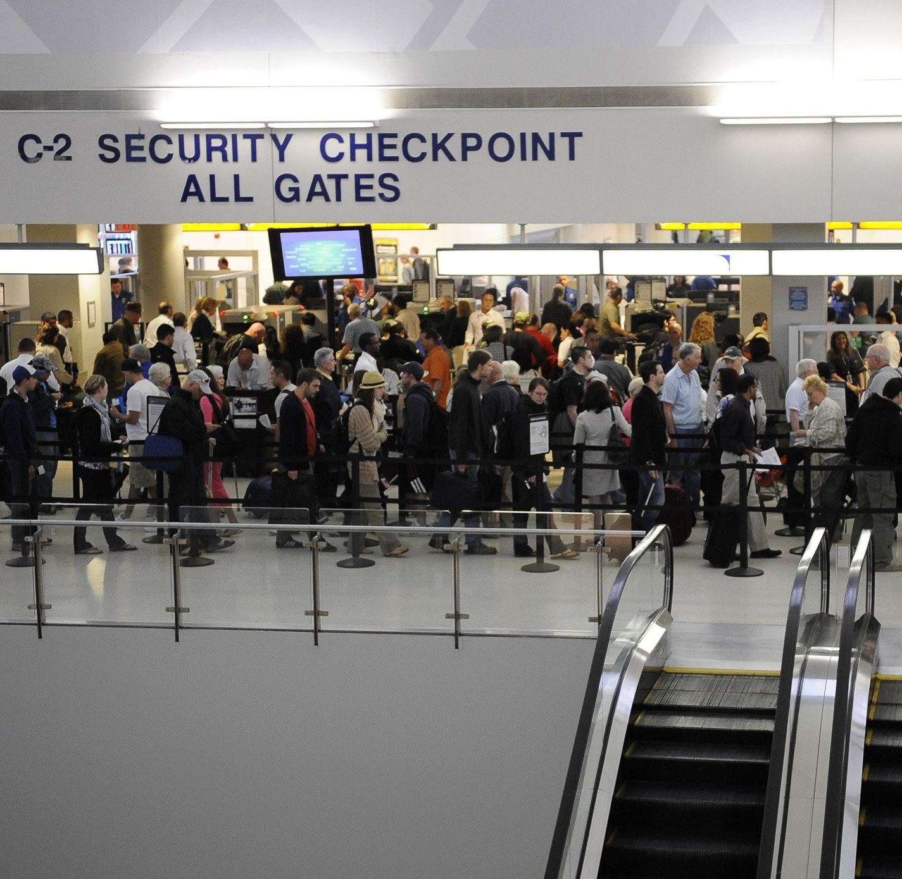
Analysis of Newark Airport
By Jeremy Randolph

Slide 2
Why Newark Airport
In 2019 Newark Airport recorded 272,205 flights
Newark Liberty is the second largest airport in the NYC area
11th largest airport in the US in 2018
In 2019 only 68.94% were on time

Slide 3
Things to Look at
What airline has the most and or worst delays?
What is the biggest reason for delay?
What destination airport sees the largest delays?
What were the top 10 worst flights in 2019?
What time of year sees the worst delays?

Slide 4
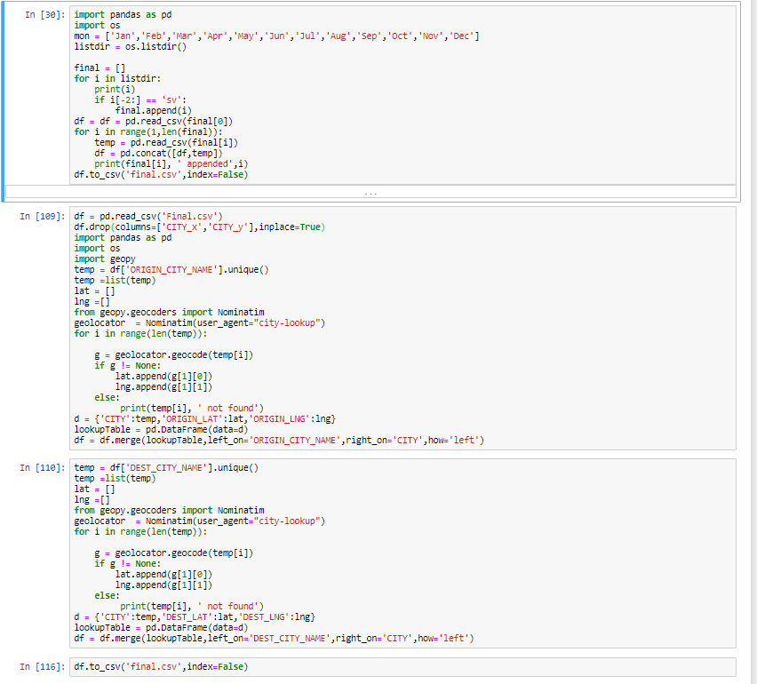
Data Set and ETL Prep
Data collected from Bureau of Transportation Statistics.
Provided data on all flight records in each region over a certain month.
Python was used to clean the data and aggregate the 12 files into one.

Slide 5
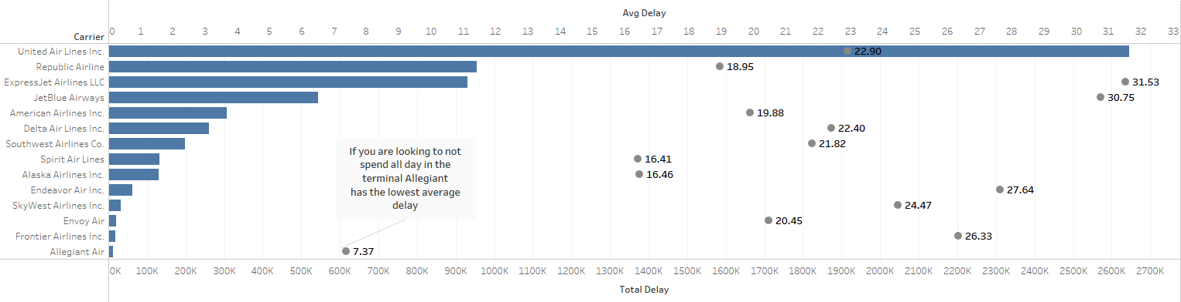
What airline has the most and or worst delays?
United Air Lines makes up the bulk of the delay time at Newark.
However ExpressJet has the worst average delay.

Slide 6
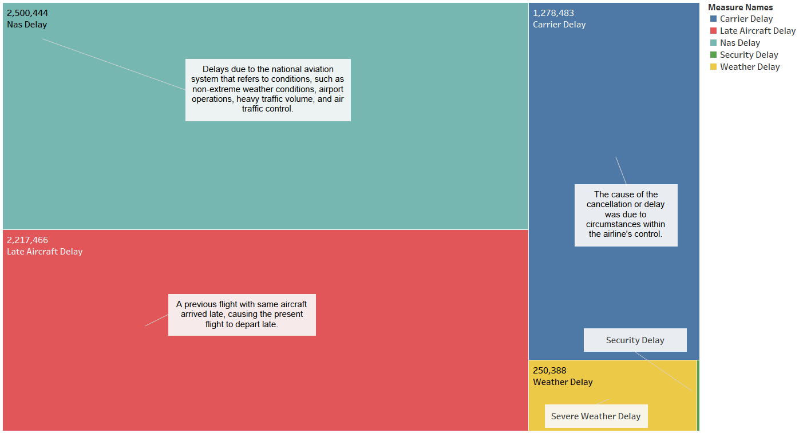
What Is the biggest reason for delay?

Slide 7
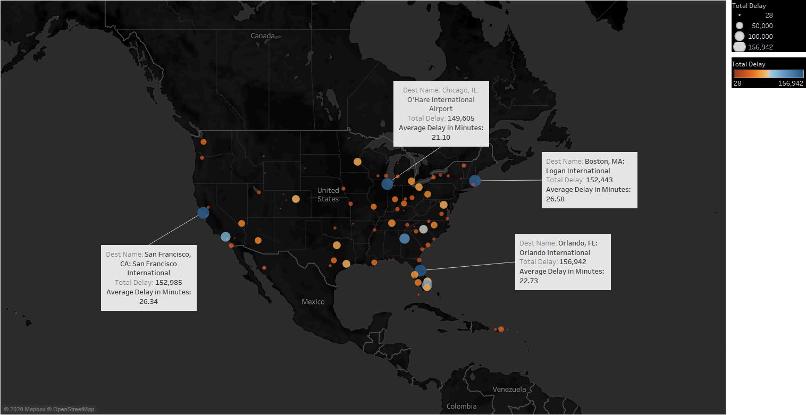
What destination airport sees the largest delays?

Slide 8
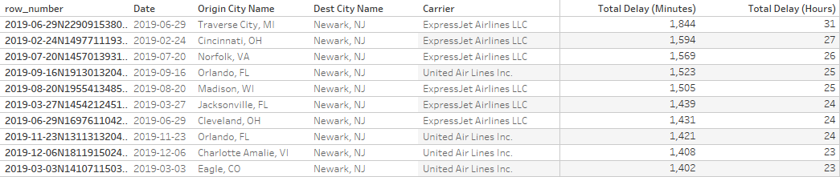
What were the top 10 worst flights by delay in 2019?

Slide 9
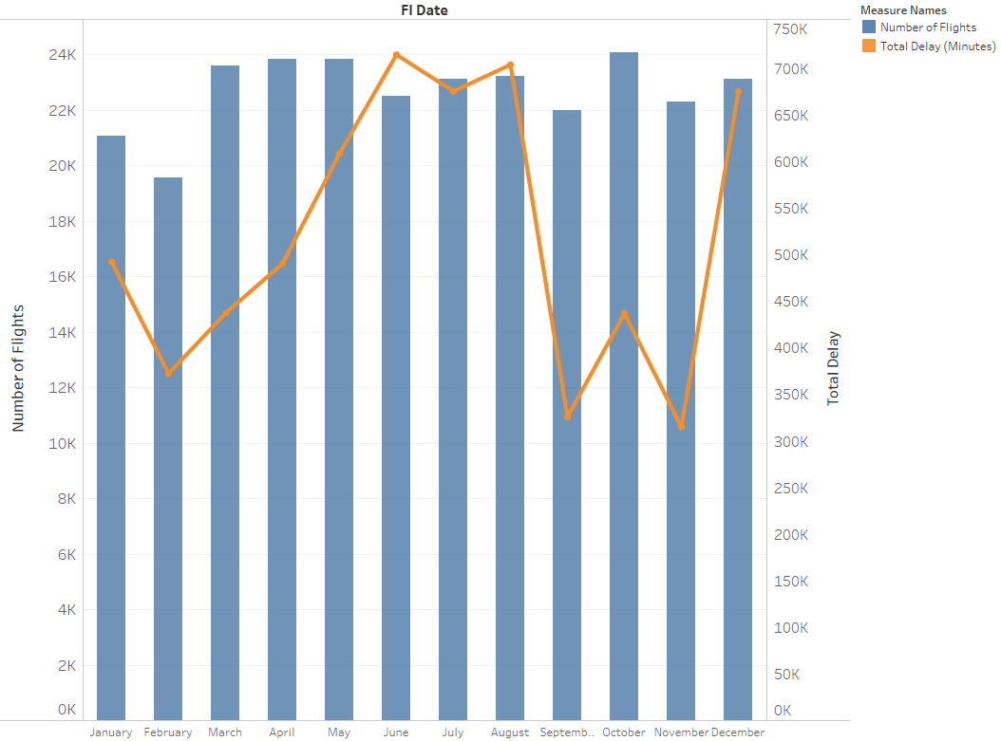
What time of year sees the worst delays?
The summer months of June, July and August as well as the holiday month of December sees the greatest delays.

Slide 10
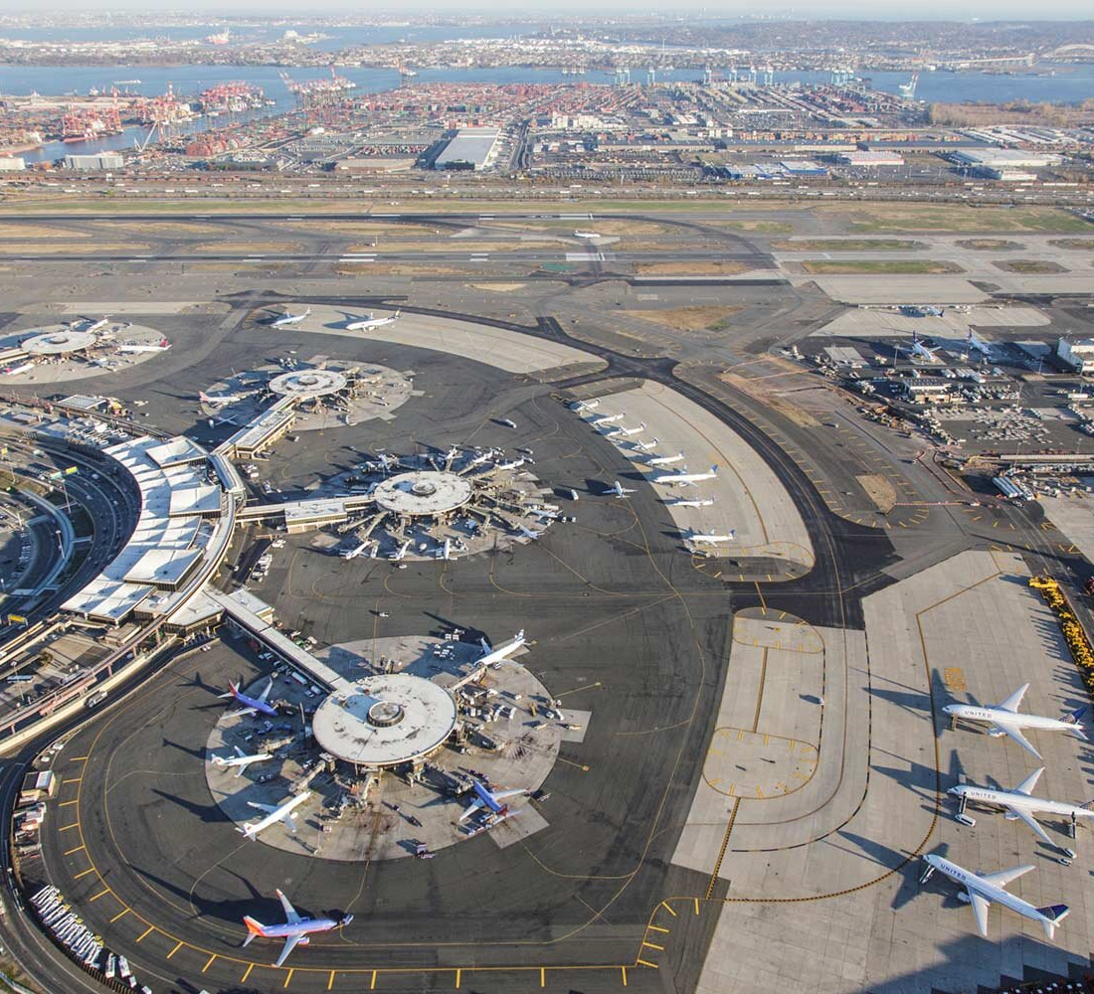
Thank you! Data Source: https://www.bts.gov/

